Slide 1
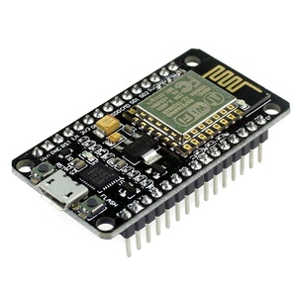
IoT With ESP8266
Mr.Prarinya Ekapho

Slide 2
Agenda for 1 days training
IoT Concept and Applications
Environment and Equipment of system
Start with Developing tools kit
Workshop#2 temperature and humidity sensor
Workshop#3 Mini project IoT 2way switch control via Smart Phone
Workshop#1 Test board NodeMCU V2

Slide 3

IoT Concept

Slide 4

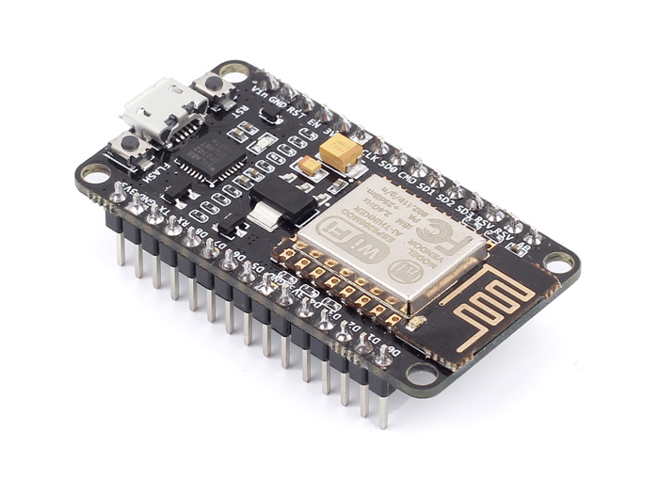



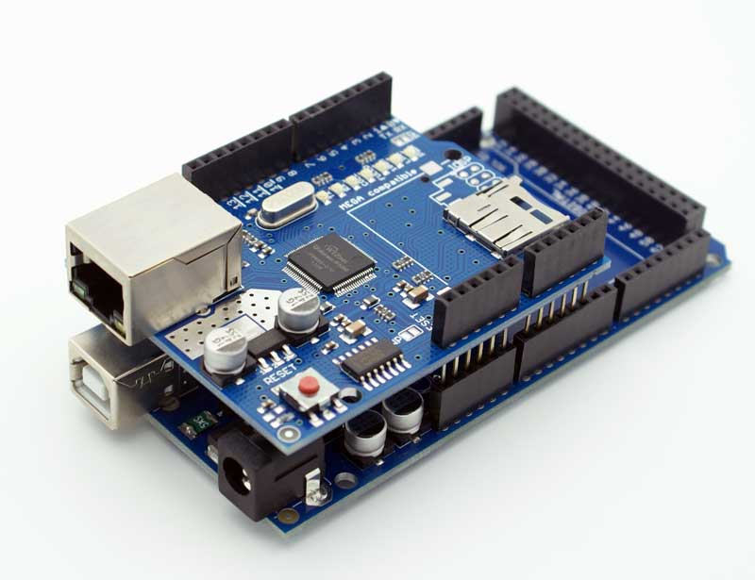
Internet of Things (IoT) Components
Things
Sensors & Controls I/O
Internet connect devices
Data
Cloud Service

Slide 5
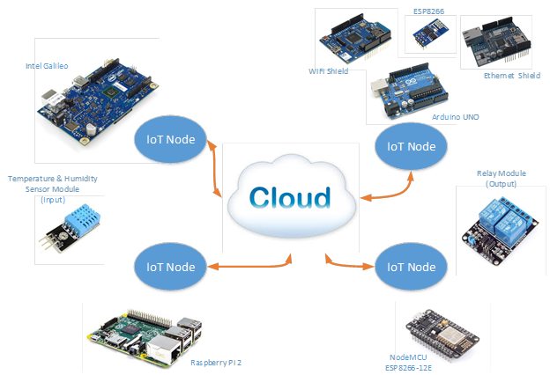
IoT Development guide

Slide 6
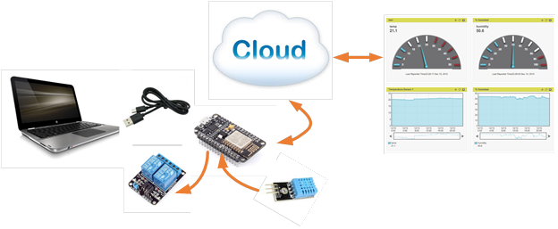
System Design concept

Slide 7
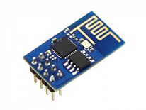
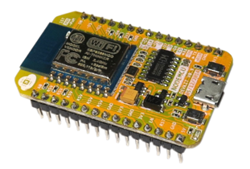
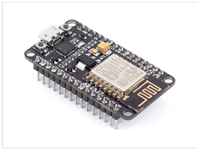
About NodeMCU ESP8266
ESP8266(ESP-01)
NodeMCU Devkit 0.9 (ESP-12) Version 1
NodeMCU Devkit 1.0 (ESP-12E) Version 2
Notes:
ESP8266 เป็นชื่อเรียกของชิฟของโมดูล ESP8266 สำหรับติดต่อสื่อสารบนมาตรฐาน WiFi ทำงานที่แรงดันไฟฟ้า 3.0-3.6V ทำงานใช้กระแสโดยเฉลี่ย 80mA รองรับคำสั่ง deep sleep ในการประหยัดพลังงาน ใช้กระแสน้อยกว่า 10 ไมโครแอมป์ สามารถ wake up กลับมาส่งข้อมูลใช้เวลาน้อยกกว่า 2 มิลลิวินาที ภายในมี Low power MCU 32bit ทำให้เราเขียนโปรแกรมสั่งงานได้ มีวงจร analog digital converter ทำให้สามารถอ่านค่าจาก analog ได้ความละเอียด 10bit ทำงานได้ที่อุณหภูมิ -40 ถึง 125 องศาเซลเซียส

Slide 8
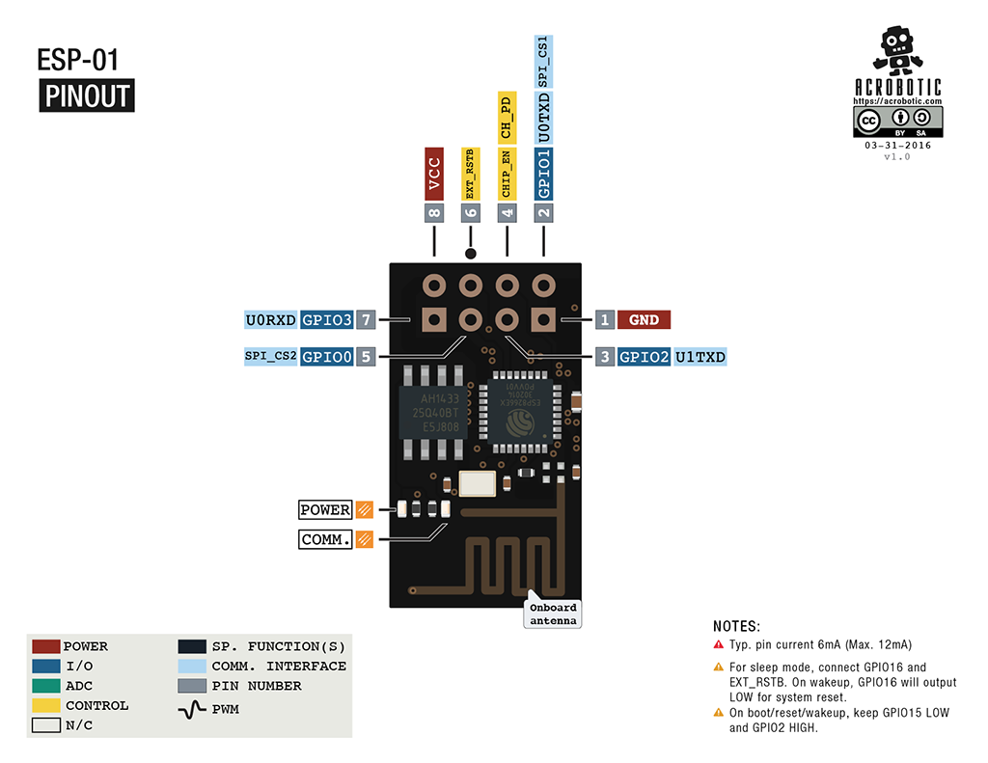
ESP8266 (ESP-01)

Slide 9
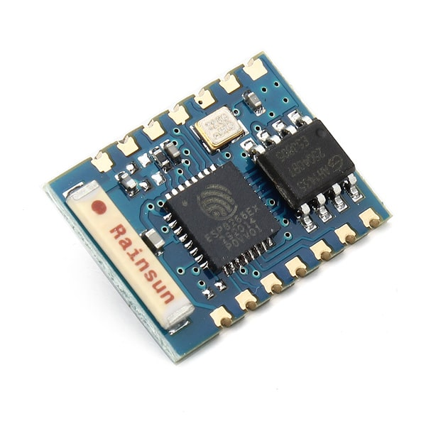
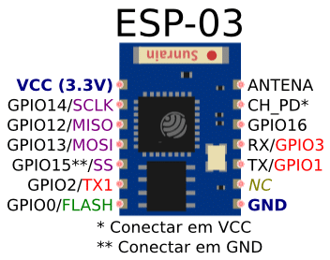
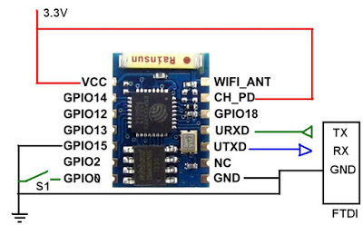
ESP8266 (ESP-03)

Slide 10
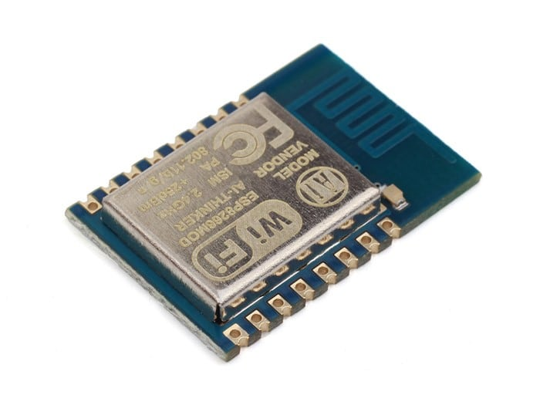
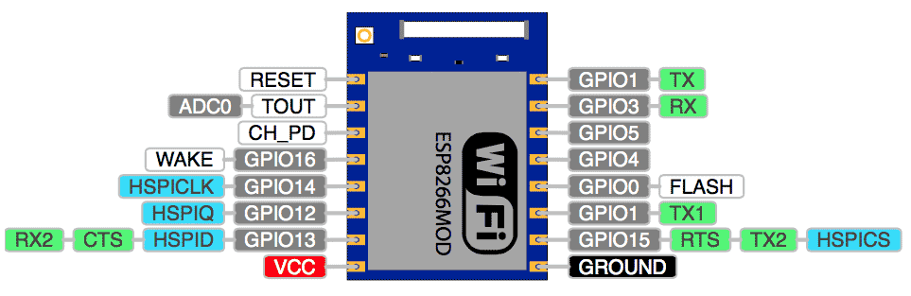
ESP8266 (ESP-07)

Slide 11
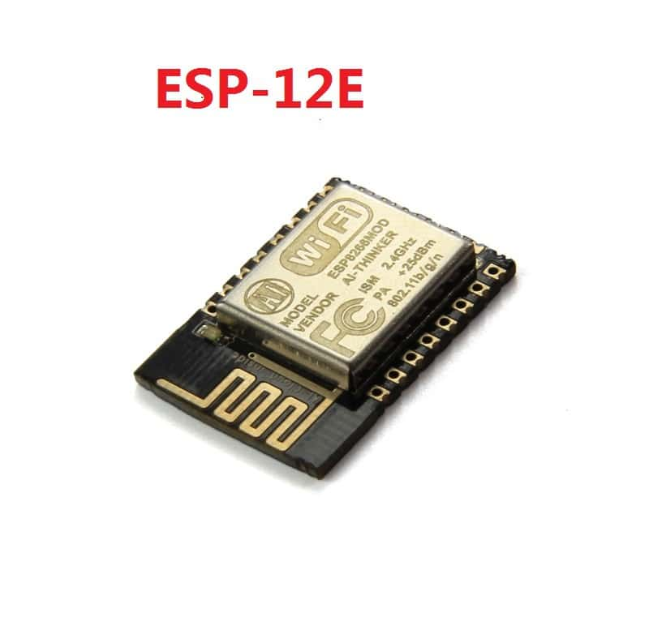
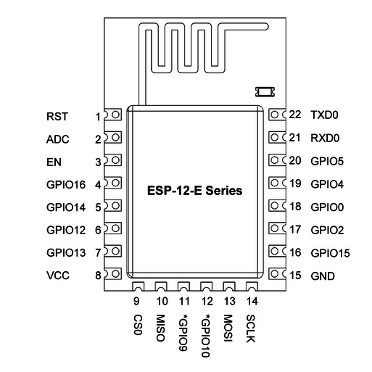
ESP8266 (ESP-12E)

Slide 12
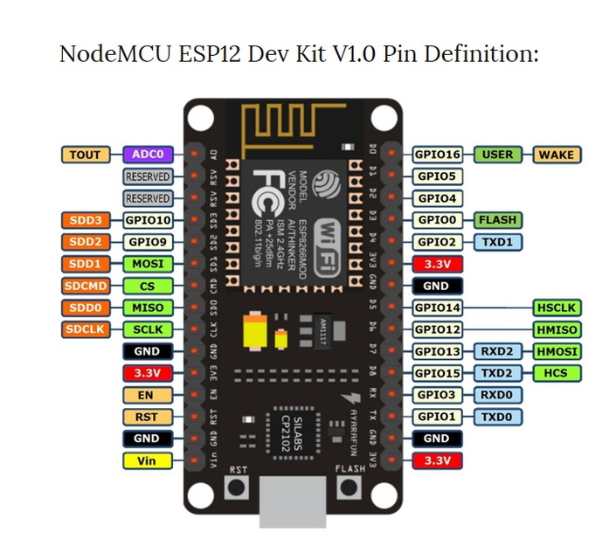
ESP8266 NodeMCU V1 Pin layout

Slide 13
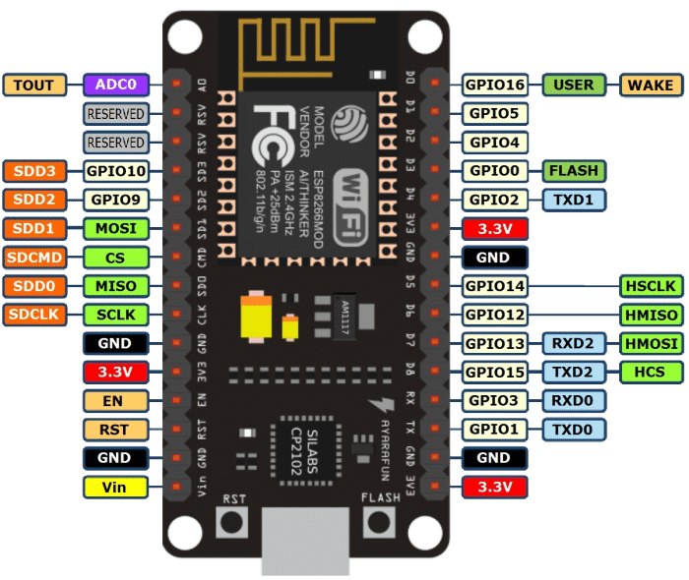
ESP8266 NodeMCU V2 Pin layout
Notes:
NodeMCU V2 เป็น ESP8266-12E รวมกับ USB TTL ที่ใช้ชิฟ CP2102 และขยายขาให้สามารถต่อทดลองได้ง่ายขึ้น มีปุ่ม reset และ flash สำหรับใช้โปรแกรม โดยใช้ Arduino IDE หรือโปรแกรมอื่น ๆ ได้อย่างสะดวก

Slide 14
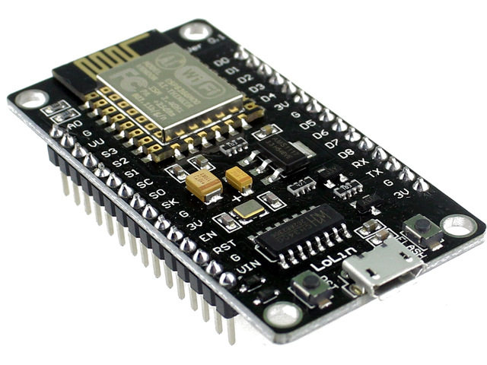
ESP8266 NodeMCU V3 Pin layout
Notes:
NodeMCU V3 เป็นบอร์ดทีคล้ายกับ NodeMCU V2 ที่ต่างกันคือ NodeMCU V3 จะมีขนาดกว้างกว่า และใช้ชิฟ USB TTL เป็น CH340 ซึ่งการต่อขาใช้งานและโคดโปรแกรมเหมือนกันทุกประการ

Slide 15
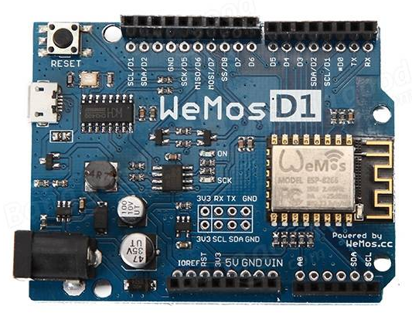
WeMos D1
Notes:
ออกแบบให้คล้ายบอร์ด Arduino Uno ใช้ ESP8266-12E เป็นตัวหลัก ชิฟ CH340 เป็นภาค USB TTL รองรับไฟ 9-12V ที่ช่อง Adapter , รองรับไฟ 5V ที่ช่อง micro usb และ 3.3V ที่ช่อง VIN

Slide 16
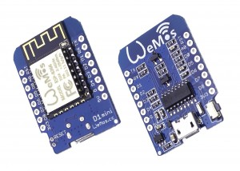
WeMos D1 Mini
Notes:
แปลงบอร์ด Wemos D1 ให้มีขนาดเล็กลง โดยการแยกส่วน usb ttl และ ESP8266-12E ข้อดีคือ เวลาใช้งานจริงสามารถถอดเฉพาะส่วน ESP8266-12E ไปใช้งาน ก็จะทำให้ประหยัดไฟได้นิดหน่อย

Slide 17
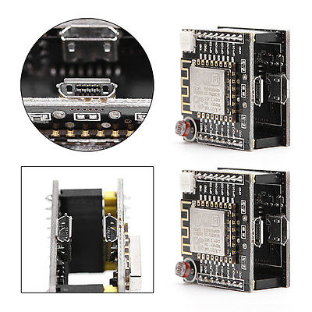
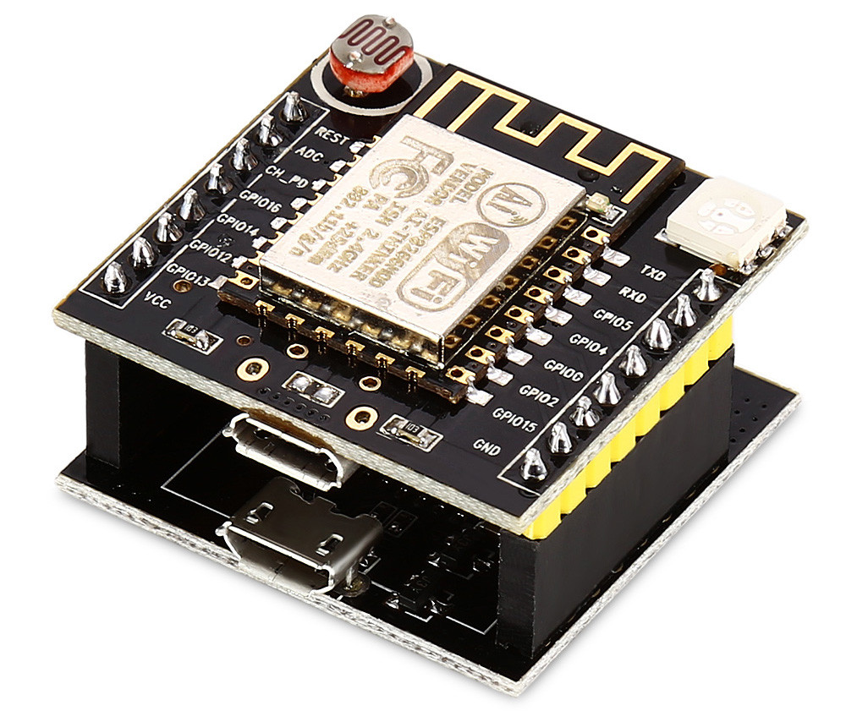
Witty cloud Mini NodeMCU
Notes:
แปลงบอร์ด Wemos D1 ให้มีขนาดเล็กลง โดยการแยกส่วน usb ttl และ ESP8266-12E ข้อดีคือ เวลาใช้งานจริงสามารถถอดเฉพาะส่วน ESP8266-12E ไปใช้งาน ก็จะทำให้ประหยัดไฟได้นิดหน่อย

Slide 18
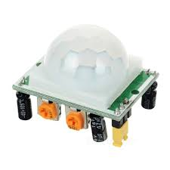
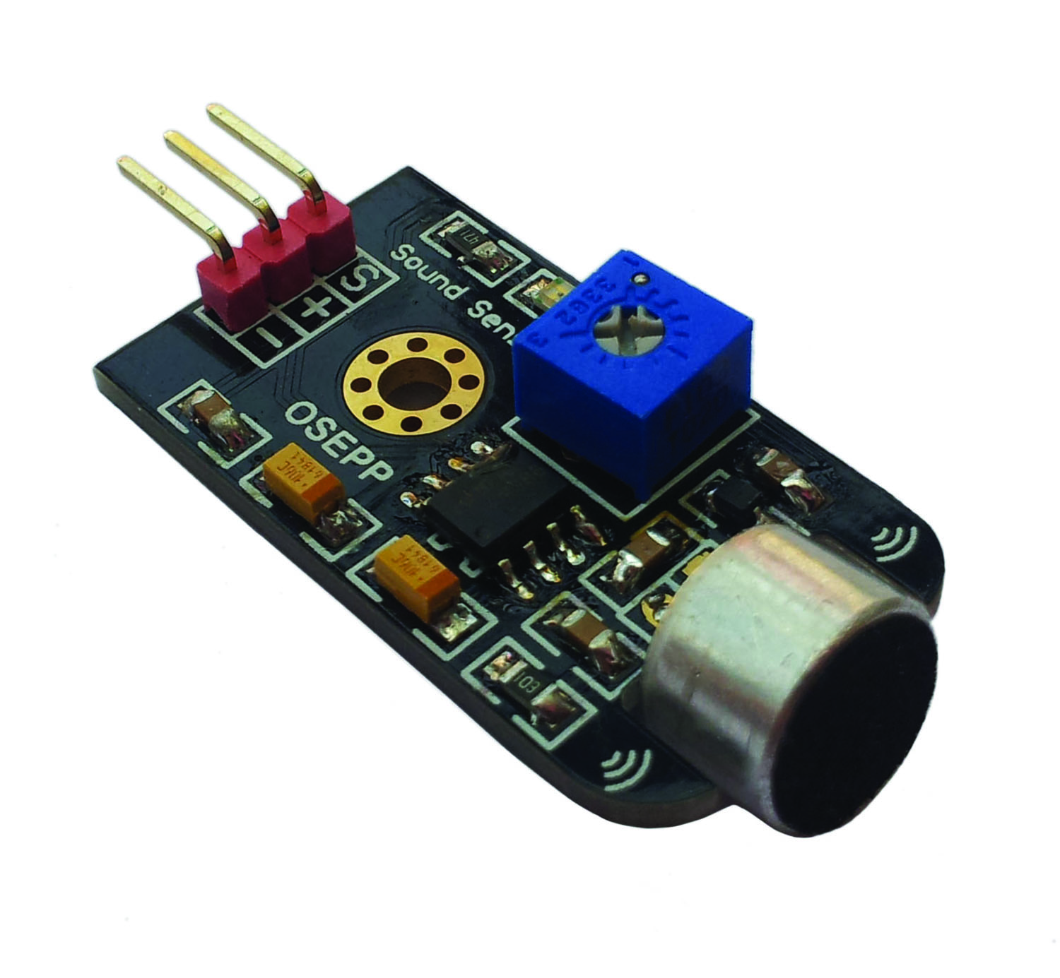
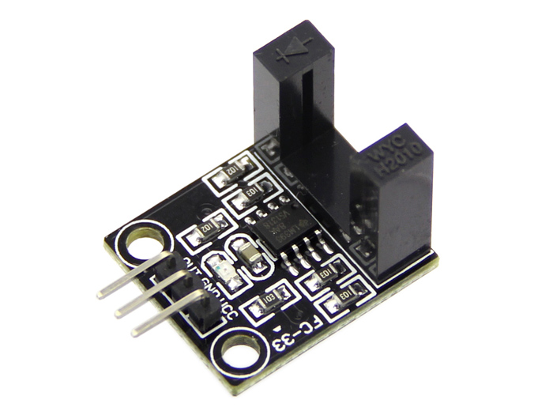
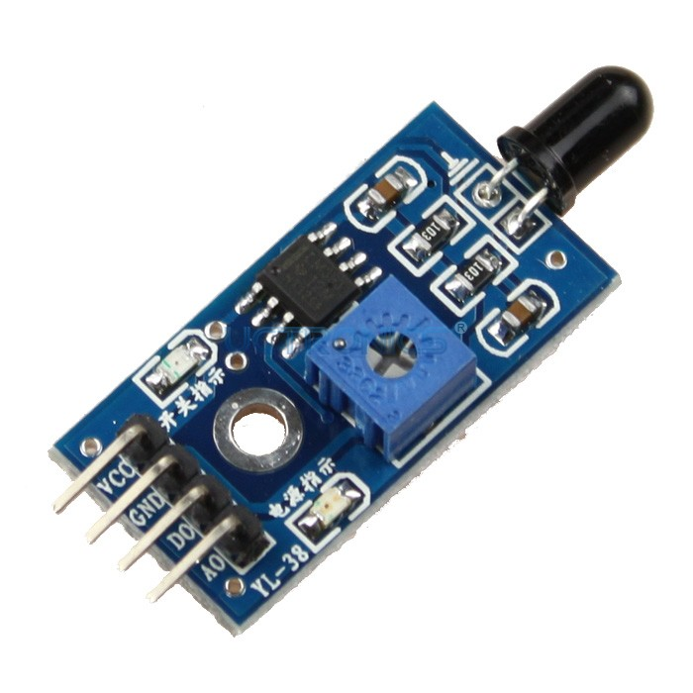
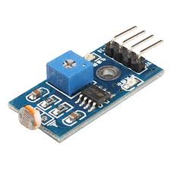
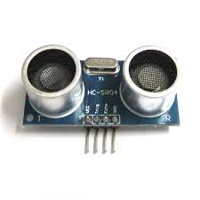
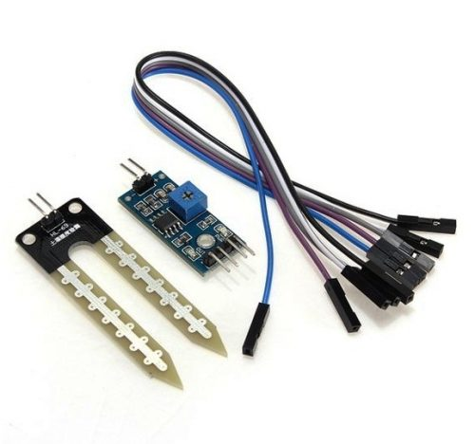
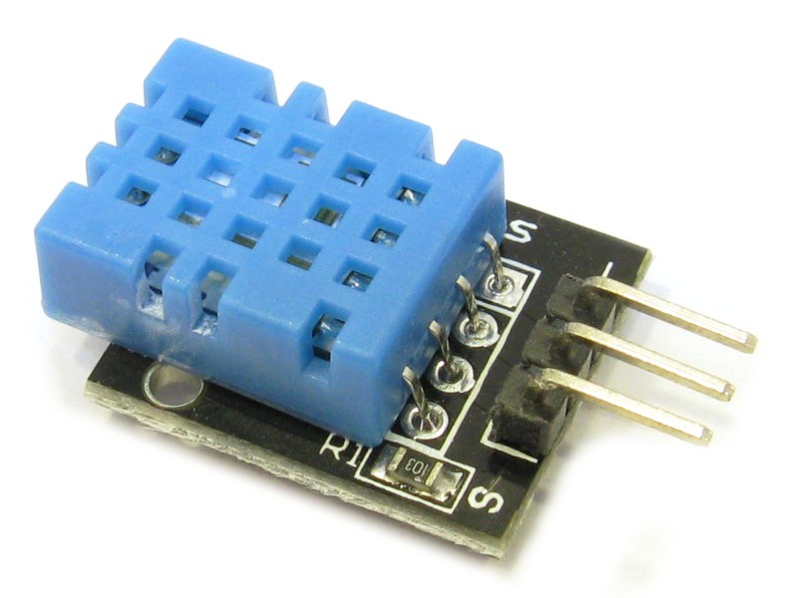
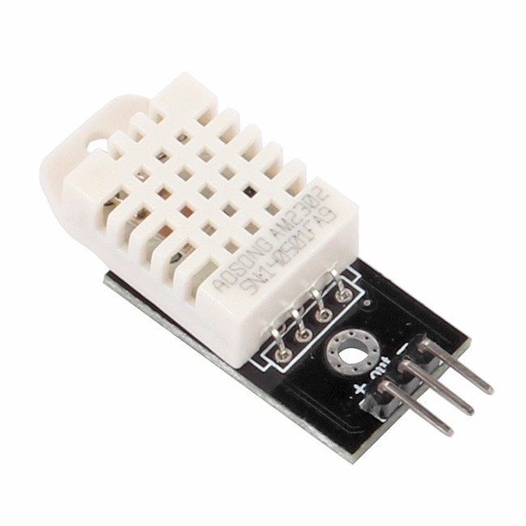
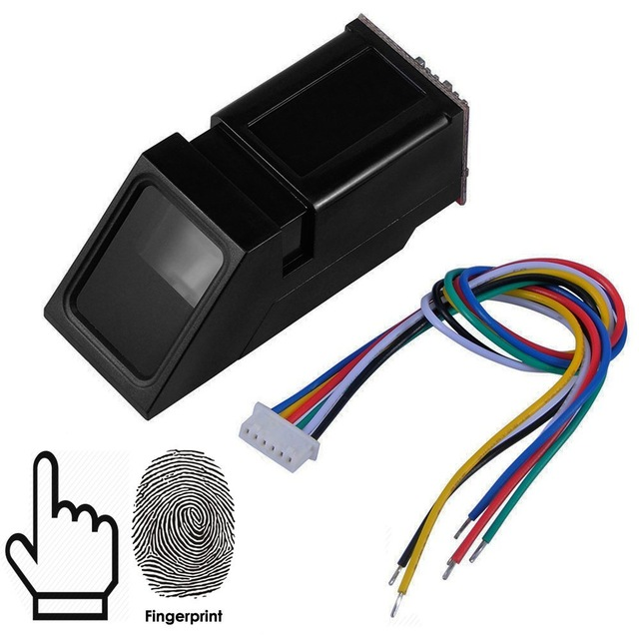
Sensor & control modules

Slide 19
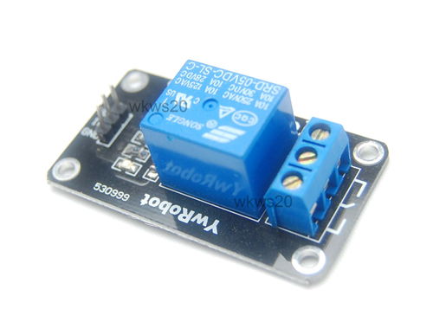
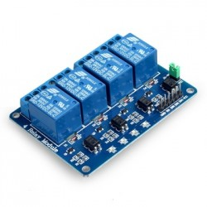
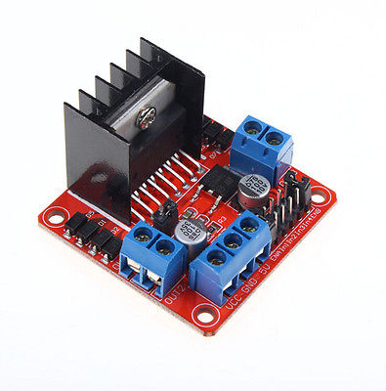
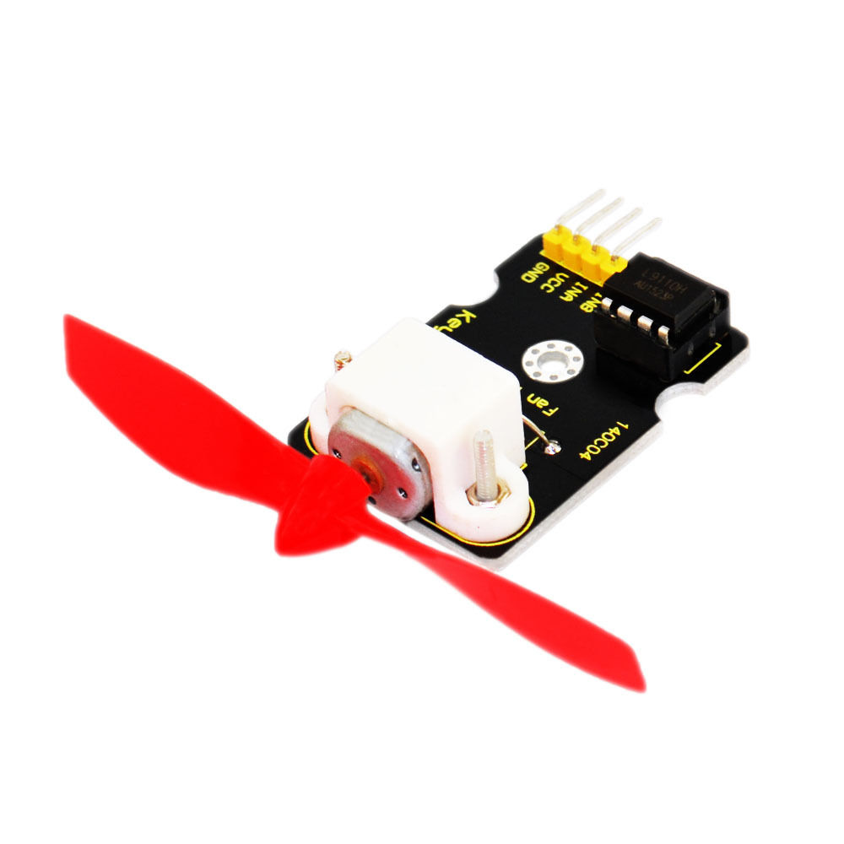
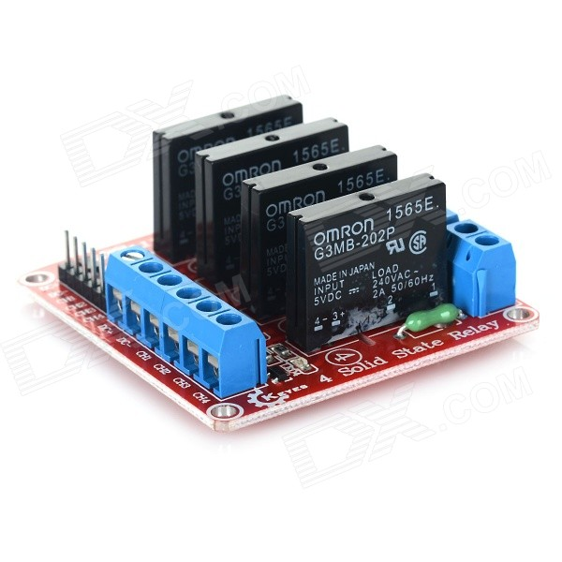
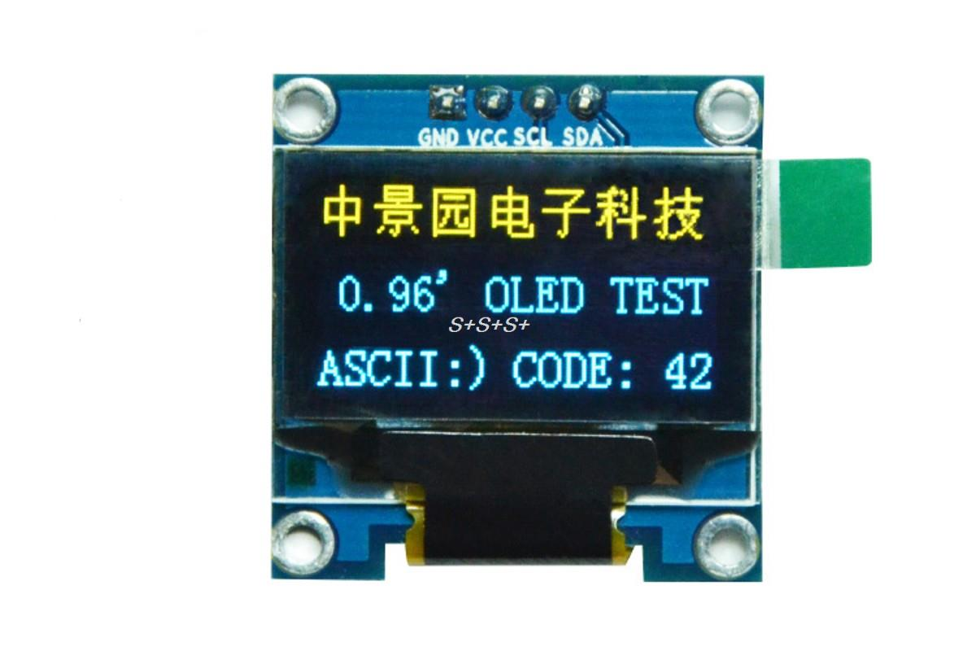
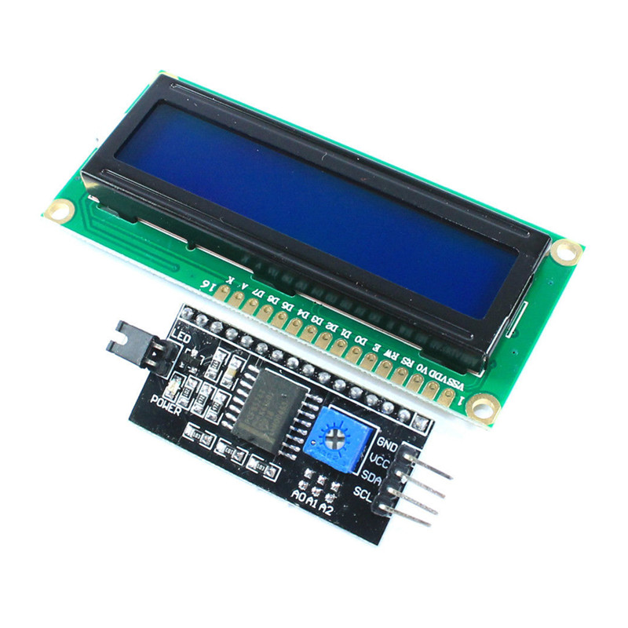
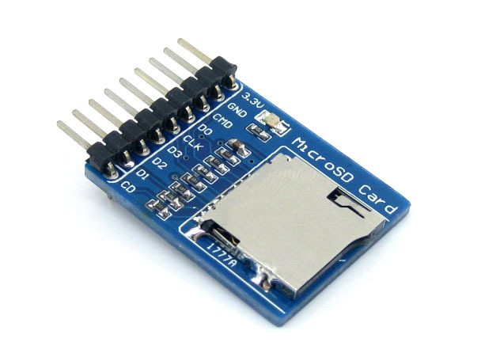
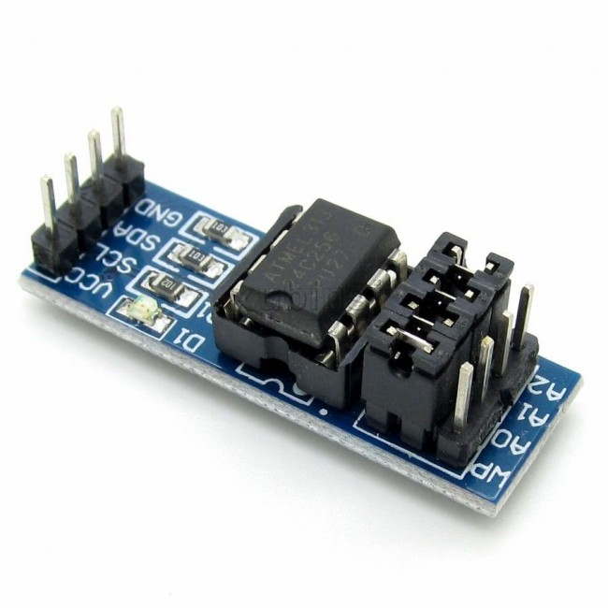
Sensor & control modules

Slide 20
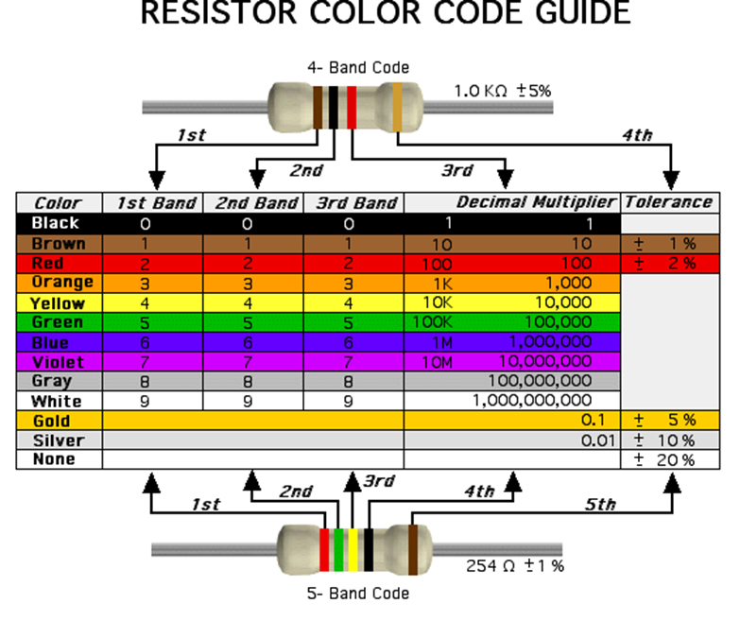

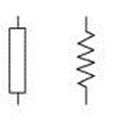
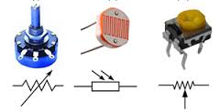
Basic electronic devices
Resistor

Slide 21
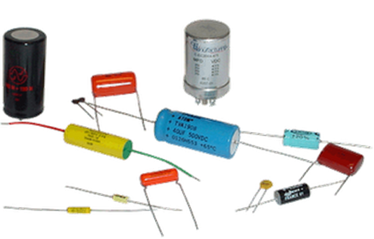
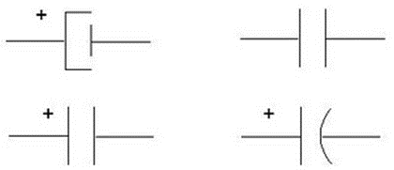
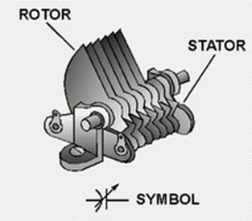
Basic electronic devices
Capacitor

Slide 22
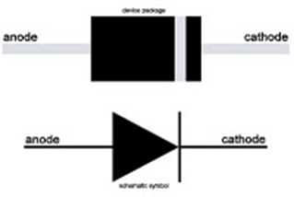
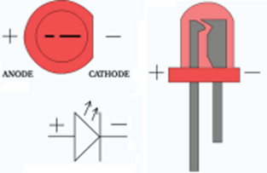
Basic electronic devices
Diode
LED

Slide 23


Slide 24
Tools for Develop
Arduino IDE and SDK for ESP8266
CP2012 USB to UART driver
Web Browser: Chrome or Firefox
1
2
3

Slide 25
Arduino IDE and SDK for ESP8266
Download and Install Arduino IDE
https://www.arduino.cc/en/Main/Software
Additional Board Manager URLs
http://arduino.esp8266.com/stable/package_esp8266com_index.json
Check Install ESP8266 in Boards Manager… Menu
esp8266 by ESP8266 Community version 2.3.0 INSTALLED

Slide 26

CP2012 USB to UART driver
https://www.silabs.com/products/mcu/Pages/USBtoUARTBridgeVCPDrivers.aspx

Slide 27
Workshop#1 Start learning ESP8266 with Arduino IDE
Blink
WiFi Scan
Web server

Slide 28

Workshop#1 Prepare hardware snap in breadboard

Slide 29
Workshop#1 [test board with blink]
void setup() {
pinMode(LED_BUILTIN, OUTPUT); // Initialize the LED_BUILTIN pin as an output
}
// the loop function runs over and over again forever
void loop() {
digitalWrite(LED_BUILTIN, LOW); // Turn the LED on (Note that LOW is the voltage level
// but actually the LED is on; this is because
// it is acive low on the ESP-01)
delay(1000); // Wait for a second
digitalWrite(LED_BUILTIN, HIGH); // Turn the LED off by making the voltage HIGH
delay(2000); // Wait for two seconds (to demonstrate the active low LED)
}

Slide 30
Workshop#1 [Wifi scan] - sketch
#include "ESP8266WiFi.h" void setup() { Serial.begin(115200); // Set WiFi to station mode and disconnect from an AP if it was previously connected WiFi.mode(WIFI_STA); WiFi.disconnect(); delay(100); Serial.println("Setup done"); } void loop() { Serial.println("scan start"); // WiFi.scanNetworks will return the number of networks found int n = WiFi.scanNetworks(); Serial.println("scan done"); if (n == 0) Serial.println("no networks found"); else | { Serial.print(n); Serial.println(" networks found"); for (int i = 0; i < n; ++i) { // Print SSID and RSSI for each network found Serial.print(i + 1); Serial.print(": "); Serial.print(WiFi.SSID(i)); Serial.print(" ("); Serial.print(WiFi.RSSI(i)); Serial.print(")"); Serial.println((WiFi.encryptionType(i) == ENC_TYPE_NONE)?" ":"*"); delay(10); } } Serial.println(""); // Wait a bit before scanning again delay(5000); }

Slide 31

Workshop#1 [Wifi scan] – serial monitor

Slide 32
Workshop#1 [wifiWeb server] – sketch
#include <ESP8266WiFi.h> const char* ssid = “your-ssid"; const char* password = “your-password"; // Create an instance of the server // specify the port to listen on as an argument WiFiServer server(80); void setup() { Serial.begin(115200); delay(10); // prepare GPIO2 pinMode(2, OUTPUT); digitalWrite(2, 0); // Connect to WiFi network Serial.println(); Serial.println(); Serial.print("Connecting to "); Serial.println(ssid); | WiFi.begin(ssid, password); while (WiFi.status() != WL_CONNECTED) { delay(500); Serial.print("."); } Serial.println(""); Serial.println("WiFi connected"); // Start the server server.begin(); Serial.println("Server started"); // Print the IP address Serial.println(WiFi.localIP()); }

Slide 33
Workshop#1 [wifiWeb server] – sketch
void loop() { // Check if a client has connected WiFiClient client = server.available(); if (!client) { return; } // Wait until the client sends some data Serial.println("new client"); while(!client.available()){ delay(1); } // Read the first line of the request String req = client.readStringUntil('\r'); Serial.println(req); client.flush(); // Match the request int val; if (req.indexOf("/gpio/0") != -1) val = 0; else if (req.indexOf("/gpio/1") != -1) val = 1; else { Serial.println("invalid request"); client.stop(); return; } | // Set GPIO2 according to the request digitalWrite(2, val); client.flush(); // Prepare the response String s = "HTTP/1.1 200 OK\r\nContent-Type: text/html\r\n\r\n<!DOCTYPE HTML>\r\n<html>\r\nGPIO is now "; s += (val)?"high":"low"; s += "</html>\n"; // Send the response to the client client.print(s); delay(1); Serial.println("Client disonnected"); // The client will actually be disconnected // when the function returns and 'client' object is detroyed }

Slide 34
Workshop#1 [wifiWeb server] – sketch GPIO5
#include <ESP8266WiFi.h> const char* ssid = “your-ssid"; const char* password = “your-password"; // Create an instance of the server // specify the port to listen on as an argument WiFiServer server(80); void setup() { Serial.begin(115200); delay(10); // prepare GPIO5 pinMode(5, OUTPUT); digitalWrite(5, 0); // Connect to WiFi network Serial.println(); Serial.println(); Serial.print("Connecting to "); Serial.println(ssid); | WiFi.begin(ssid, password); while (WiFi.status() != WL_CONNECTED) { delay(500); Serial.print("."); } Serial.println(""); Serial.println("WiFi connected"); // Start the server server.begin(); Serial.println("Server started"); // Print the IP address Serial.println(WiFi.localIP()); }

Slide 35
Workshop#1 [wifiWeb server] – sketch GPIO5
void loop() { // Check if a client has connected WiFiClient client = server.available(); if (!client) { return; } // Wait until the client sends some data Serial.println("new client"); while(!client.available()){ delay(1); } // Read the first line of the request String req = client.readStringUntil('\r'); Serial.println(req); client.flush(); // Match the request int val; if (req.indexOf("/gpio/0") != -1) val = 0; else if (req.indexOf("/gpio/1") != -1) val = 1; else { Serial.println("invalid request"); client.stop(); return; } | // Set GPIO5 according to the request digitalWrite(5, val); client.flush(); // Prepare the response String s = "HTTP/1.1 200 OK\r\nContent-Type: text/html\r\n\r\n<!DOCTYPE HTML>\r\n<html>\r\nGPIO is now "; s += (val)?"high":"low"; s += "</html>\n"; // Send the response to the client client.print(s); delay(1); Serial.println("Client disonnected"); // The client will actually be disconnected // when the function returns and 'client' object is detroyed }

Slide 36

Workshop#1 [wifiWeb server] – serial monitor

Slide 37


Workshop#1 [wifiWeb server] – web browser

Slide 38

Workshop#1 [helloserver]

Slide 39

Workshop#1 [helloserver]

Slide 40

Workshop#1 [helloserver]-serial monitor

Slide 41

Workshop#1 [helloserver]-web browser

Slide 42
Workshop#2 upload data to cloud (thinkspeak)
Apply Thinkspeak
Test send data
Customize visual board

Slide 43
Workshop#2 Apply Thinkspeak
1
Register Thingspeak
2
Create New Channel
3
Receive API Key
4
Use API Key send data to server

Slide 44

Workshop#2 Apply Thinkspeak

Slide 45

Workshop#2 Apply Thinkspeak

Slide 46

Workshop#2 Apply Thinkspeak

Slide 47

Workshop#2 Create New Channel

Slide 48


Workshop#2 Create New Channel

Slide 49

Workshop#2 Create New Channel

Slide 50


Workshop#2 Create New Channel

Slide 51

Workshop#2 connect hardware

Slide 52
Workshop#2 sketch for test
#include "DHT.h" #include <ESP8266WiFi.h> #define PUMP_RLY 4 // output drive relay for pump GPIO4 (D2) #define DHTPIN 2 // what pin we're connected to GPIO2 (D4) #define DHTTYPE DHT11 // DHT 11 #define DEBUG #define DEBUG_PRINTER Serial #ifdef DEBUG #define DEBUG_PRINT(...) { DEBUG_PRINTER.print(__VA_ARGS__); } #define DEBUG_PRINTLN(...) { DEBUG_PRINTER.println(__VA_ARGS__); } #else #define DEBUG_PRINT(...) {} #define DEBUG_PRINTLN(...) {} #endif const char* ssid = “SSID"; //Use own ssid const char* password = “PASSWORD"; //use password of AP DHT *dht; void connectWifi(); void reconnectWifiIfLinkDown(); void initDht(DHT **dht, uint8_t pin, uint8_t dht_type); void readDht(DHT *dht, float *temp, float *humid); void uploadThingsSpeak(float t, float h); | void setup() { Serial.begin(115200); delay(10); pinMode(PUMP_RLY, OUTPUT); // Initialize the PUMP_RLY(4) pin as an output digitalWrite(PUMP_RLY, HIGH);// Make sure relay is normal off connectWifi(); initDht(&dht, DHTPIN, DHTTYPE); } void loop() { static float t_dht; static float h_dht; readDht(dht, &t_dht, &h_dht); if(h_dht < 30 || t_dht > 26) // condition for make relay on { digitalWrite(PUMP_RLY, LOW); //If condition true do this! } else { digitalWrite(PUMP_RLY, HIGH); } uploadThingsSpeak(t_dht, h_dht); // Wait a few seconds between measurements. delay(10 * 1000); reconnectWifiIfLinkDown(); }

Slide 53
Workshop#2 sketch for test
void reconnectWifiIfLinkDown() { if (WiFi.status() != WL_CONNECTED) { DEBUG_PRINTLN("WIFI DISCONNECTED"); connectWifi(); } } void connectWifi() { DEBUG_PRINTLN(); DEBUG_PRINTLN(); DEBUG_PRINT("Connecting to "); DEBUG_PRINTLN(ssid); WiFi.begin(ssid, password); while (WiFi.status() != WL_CONNECTED) { delay(500); DEBUG_PRINT("."); } DEBUG_PRINTLN(""); DEBUG_PRINTLN("WiFi connected"); DEBUG_PRINTLN("IP address: "); DEBUG_PRINTLN(WiFi.localIP()); } void initDht(DHT **dht, uint8_t pin, uint8_t dht_type) { // Connect pin 1 (on the left) of the sensor to +5V // NOTE: If using a board with 3.3V logic like an Arduino Due | connect pin 1 // to 3.3V instead of 5V! // Connect pin 2 of the sensor to whatever your DHTPIN is // Connect pin 4 (on the right) of the sensor to GROUND // Connect a 10K resistor from pin 2 (data) to pin 1 (power) of the sensor // Initialize DHT sensor for normal 16mhz Arduino // NOTE: For working with a faster chip, like an Arduino Due or Teensy, you // might need to increase the threshold for cycle counts considered a 1 or 0. // You can do this by passing a 3rd parameter for this threshold. It's a bit // of fiddling to find the right value, but in general the faster the CPU the // higher the value. The default for a 16mhz AVR is a value of 6. For an // Arduino Due that runs at 84mhz a value of 30 works. // Example to initialize DHT sensor for Arduino Due: //DHT dht(DHTPIN, DHTTYPE, 30); *dht = new DHT(pin, dht_type, 30); (*dht)->begin(); DEBUG_PRINTLN(F("DHTxx test!")) ; }

Slide 54
Workshop#2 sketch for test
void uploadThingsSpeak(float t, float h) { static const char* host = "api.thingspeak.com"; static const char* apiKey = “YOUR_APIKEY"; // Use WiFiClient class to create TCP connections WiFiClient client; const int httpPort = 80; if (!client.connect(host, httpPort)) { DEBUG_PRINTLN("connection failed"); return; } // We now create a URI for the request String url = "/update/"; // url += streamId; url += "?key="; url += apiKey; url += "&field1="; url += t; url += "&field2="; url += h; DEBUG_PRINT("Requesting URL: "); DEBUG_PRINTLN(url); // This will send the request to the server client.print(String("GET ") + url + " HTTP/1.1\r\n" + "Host: " + host + "\r\n" + "Connection: close\r\n\r\n"); } | void readDht(DHT *dht, float *temp, float *humid) { if (dht == NULL) { DEBUG_PRINTLN(F("[dht11] is not initialised. please call initDht() first.")); return; } // Reading temperature or humidity takes about 250 milliseconds! // Sensor readings may also be up to 2 seconds 'old' (its a very slow sensor) float h = dht->readHumidity(); // Read temperature as Celsius float t = dht->readTemperature(); // Read temperature as Fahrenheit float f = dht->readTemperature(true); // Check if any reads failed and exit early (to try again). if (isnan(h) || isnan(t) || isnan(f)) { DEBUG_PRINTLN("Failed to read from DHT sensor!"); return; }

Slide 55
Workshop#2 sketch for test
// Compute heat index // Must send in temp in Fahrenheit! float hi = dht->computeHeatIndex(f, h); DEBUG_PRINT("Humidity: "); DEBUG_PRINT(h); DEBUG_PRINT(" %\t"); DEBUG_PRINT("Temperature: "); DEBUG_PRINT(t); DEBUG_PRINT(" *C "); DEBUG_PRINT(f); DEBUG_PRINT(" *F\t"); DEBUG_PRINT("Heat index: "); DEBUG_PRINT(hi); DEBUG_PRINTLN(" *F"); *temp = t; *humid = h; }

Slide 56

Customize visual board

Slide 57

Customize visual board

Slide 58

Workshop#3 Mini Project 2Way IoT Switch

Slide 59


Workshop#3 Control IoT via Blynk

Slide 60




Workshop#3 Control IoT via Blynk

Slide 61

Workshop#3 Control IoT via Blynk

Slide 62


Workshop#3 Control IoT via Blynk

Slide 63

Workshop#3 Control IoT via Blynk

Slide 64


Workshop#3 Control IoT via Blynk
#define BLYNK_PRINT Serial // Comment this out to disable prints and save space #include <ESP8266WiFi.h> #include <BlynkSimpleEsp8266.h> // You should get Auth Token in the Blynk App. // Go to the Project Settings (nut icon). char auth[] = "7c66a2b373a148b8a9b9470a0da38f87"; // Your WiFi credentials. // Set password to "" for open networks. char ssid[] = "comptia"; char pass[] = "comptiatc"; void setup() { Serial.begin(115200); Blynk.begin(auth, ssid, pass); } void loop() { Blynk.run(); }

Slide 65

Workshop#3 Temp Control IoT via Blynk

Slide 66
Workshop#4 Control IoT via Blynk
#define BLYNK_PRINT Serial // Comment this out to disable prints and save space #include <ESP8266WiFi.h> #include <BlynkSimpleEsp8266.h> #include <SimpleTimer.h> #include <Adafruit_Sensor.h> #include <DHT.h> #include <DHT_U.h> #define DHTPIN 12 #define DHTTYPE DHT11 DHT_Unified dht(DHTPIN, DHTTYPE); char auth[] = "8c028718194743109fd45f2fb720cc14"; SimpleTimer timer; void setup() { Serial.begin(115200); Blynk.begin(auth, "comptia", "comptiatc"); dht.begin(); | // Setup a function to be called every second timer.setInterval(5000L, sendUptime); } void sendUptime() { Blynk.virtualWrite(V5, millis() / 1000); sensors_event_t event; dht.temperature().getEvent(&event); if (!isnan(event.temperature)) { Blynk.virtualWrite(V1, event.temperature); } dht.humidity().getEvent(&event); if (!isnan(event.relative_humidity)) { Blynk.virtualWrite(V2, event.relative_humidity); } } void loop() { Blynk.run(); timer.run(); }

Slide 67

Question….

Slide 68
Further resources
https://www.arduino.cc/
https://thingspeak.com/
https://netpie.io/
https://espressif.com/en/products/hardware/esp8266ex/overview
http://www.esp8266.com/
http://www.blynk.cc/
https://www.rs-online.com/designspark/rs-toolbox

Slide 69


Course feedback and instructor evaluation

Slide 70
Final Question….
Email: prarinya.e@gmail.com

Slide 71


